Slide 1
1. Ron & MeLea do powerpoint, Erik, Priya & Reilly do visualizations & demos
Ron
Intro: 1-4
Database: 5
Data exploration: 6-8
MeLea
Prelim feature selection: 9
Data Processing: 10
Model Performance: 11
Feature Importance: 12-13
Project Eval/takeaways: 15
Priya
Dashboard demo
Erik & Reilly
Visualizations
2. Reilly, Ron & MeLea do powerpoint, Erik & Priya do visualizations & demos
Reilly
Intro: 1-4
Ron
Database: 5
Data exploration: 6-8
Prelim feature selection: 9
MeLea
Data Processing: 10
Model Performance: 11
Feature Importance: 12-13
Project Eval/takeaways: 15
Priya
Dashboard demo
Erik
Visualizations
3. Priya, Ron & MeLea do powerpoint, Erik & Reilly do visualizations & demos
Priya
Intro: 1-4
Ron
Database: 5
Data exploration: 6-8
Prelim feature selection: 9
MeLea
Data Processing: 10
Model Performance: 11
Feature Importance: 12-13
Project Eval/takeaways: 15
Erik
Dashboard demo
Reilly
Visualizations

Slide 2
Employee Attrition

Slide 3
What’s important about Employee Attrition?
With the prevalence of remote work it is easy for employees to change companies. There are many hidden costs of hiring a new employee, which makes turnover very expensive for all companies.
Hidden Costs of Attrition
Recruiting
HR costs
Background checks
Loss of productive hours
Training hours
Costs of benefits packages

Slide 4
Question and Data
Based on data collected by Human Resources, are we able to predict the factors that cause an employee to leave the company?
Data Source: IBM Human Resources data collected across the company
https://github.com/IBM/employee-attrition-aif360/blob/master/data/emp_attrition.csv

Slide 5
Technologies Used
Jupyter Notebook
Pandas
PostgreSQL
Tableau
Numpy
Matplotlib
Seaborn
Python

Slide 6
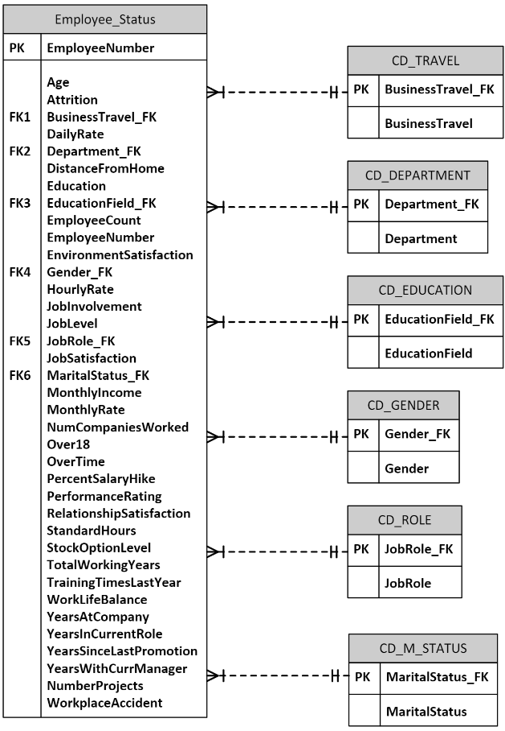
Entity Relational Diagram

Slide 7
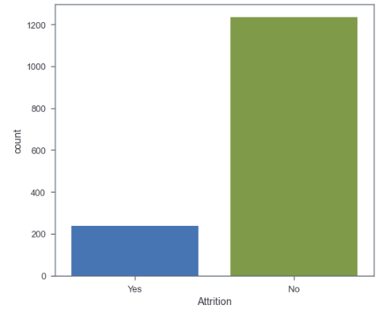
Data Exploration
Clean data
Check columns/nulls: 37 columns
Explore data types
Count target variable values
Attrition – No: 1233
Attrition – Yes: 237

Slide 8
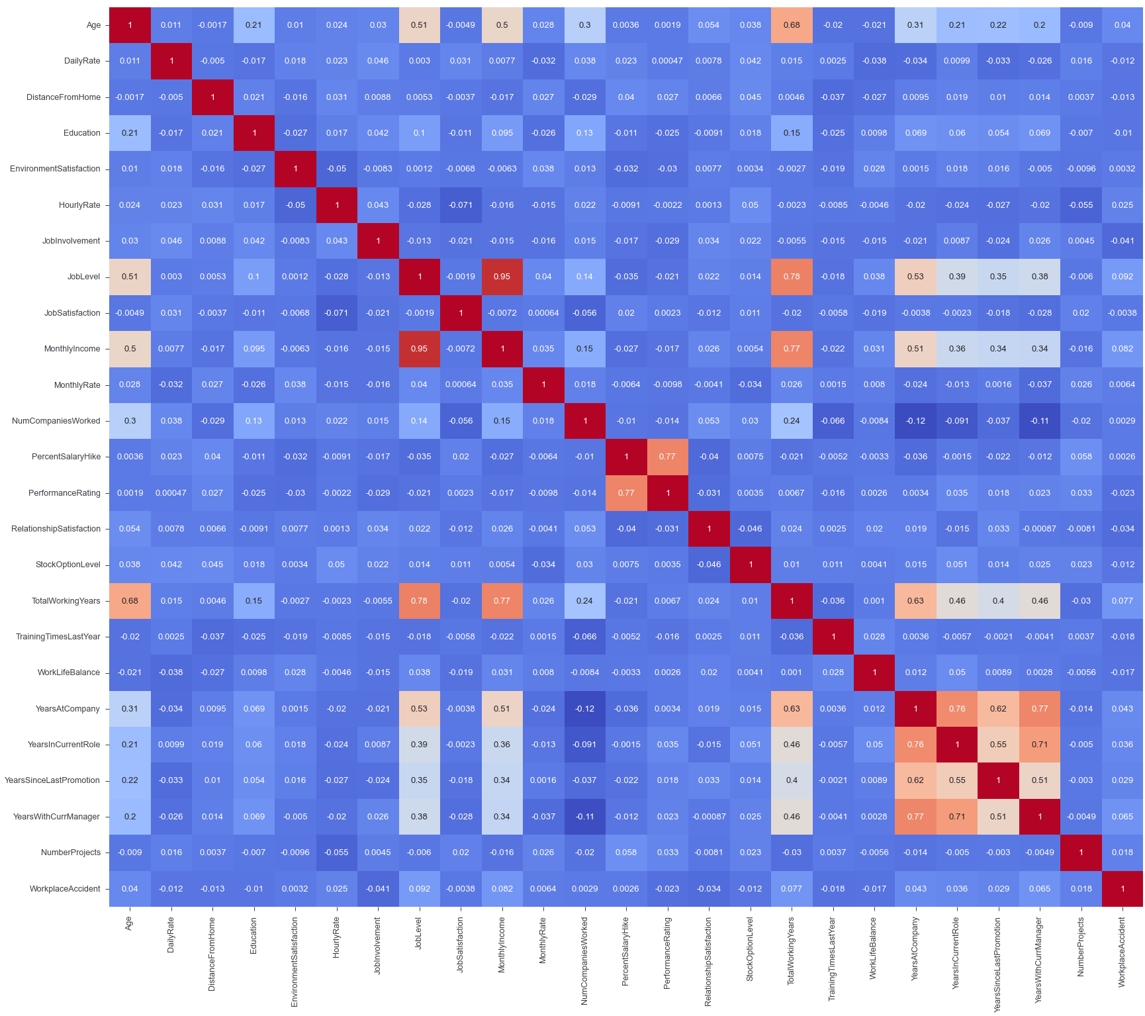
Data Exploration
Examine correlations between features

Slide 9
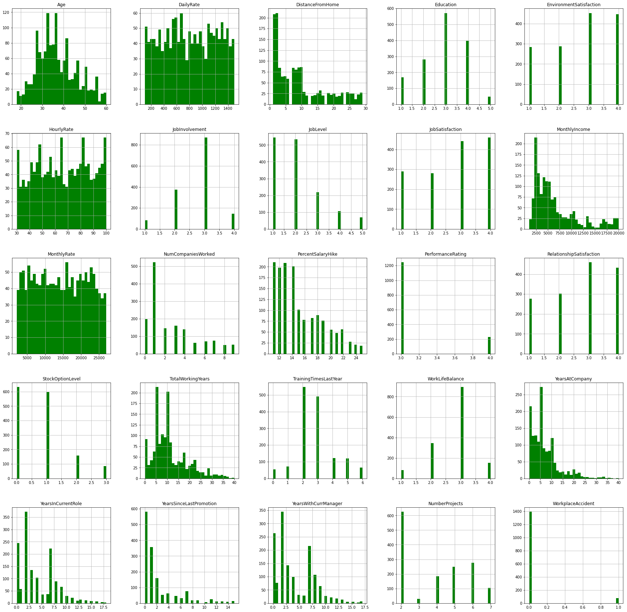
Data Exploration
Examine distribution of numerical features

Slide 10
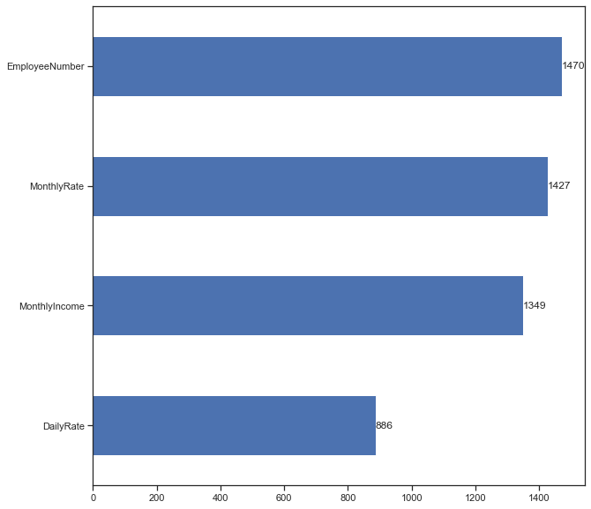
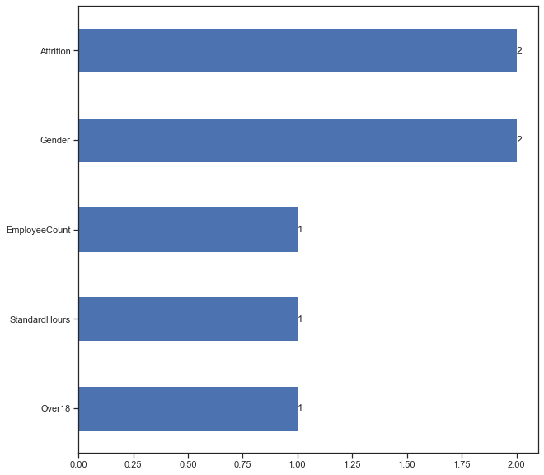
Preliminary Feature Selection: Eliminate columns that do not provide information
Employee Number:
1470 rows with 1470 unique values
Employee Count, Standard Hours, Over 18:
1 unique value per row

Slide 11
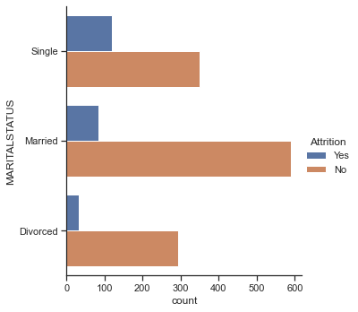
Data Processing
Transform categorical columns using OneHotEncoder
8 of 33 columns transformed
Split data into feature & target
Target: ‘Attrition_Yes’
Split using train_test_split
test_size = 0.20
random_state=78
Scaling: StandardScaler
Notes:
Graph is an example of one of the categorical variables transformed with one-hot encoder
Split data shapes:
X_train (1176, 53)
X_test (294, 53)
y_train (1176,)
y_test (294,)

Slide 12
Machine Learning Models Evaluated
Model | Accuracy Score | Tuned Accuracy Score
Logistic Regression | 87.228% | 89.796%
Random Forest Classifier | 87.772% | 86.735%
Support Vector Machine | 87.228% | 89.116%
XG Boost | 88.315% | 87.755%
Naïve Bayes | 71.467% | 62.585%
Notes:
Based on accuracy score, we selected logistic regression

Slide 13
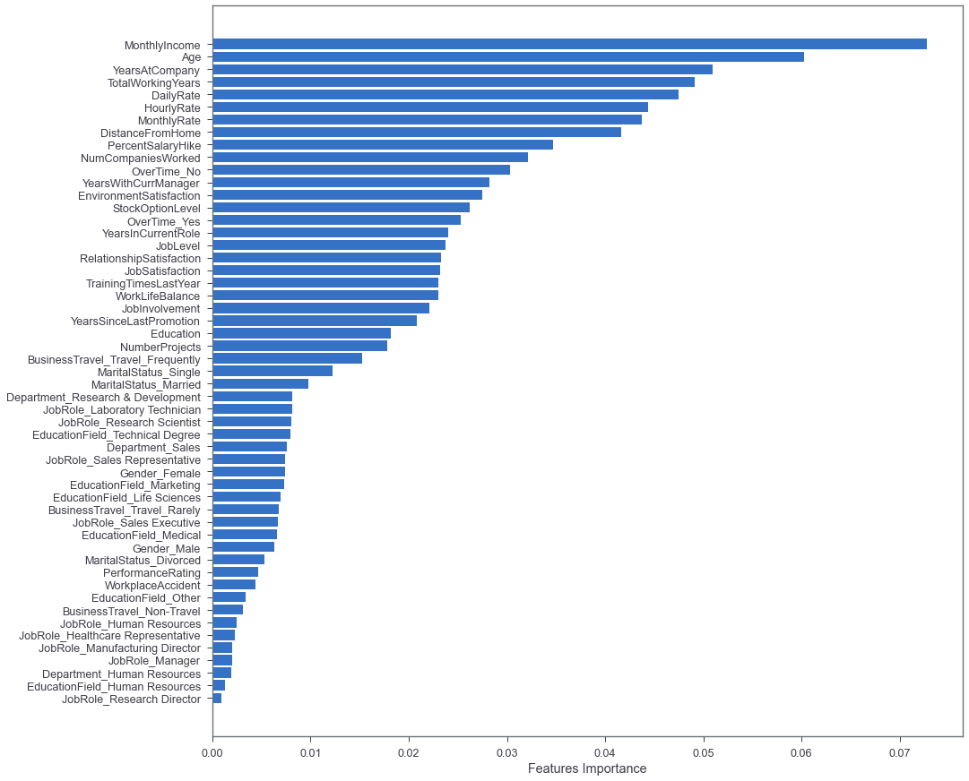
Additional Feature Selection: Logistic Regression Feature Importance

Slide 14
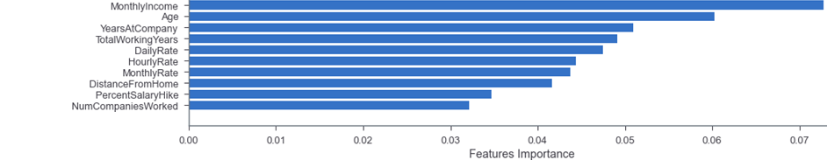
Logistic Regression Top 10 Features

Slide 15
What we would have done differently:
Focus on improving model accuracy:
Explore additional hyperparameter tuning options
Feature reduction
Try additional models
Play with modifying variables
Evaluate neural network
Recommendations for Future Analysis

Slide 16
Dashboard & Visualizations
https://github.com/lykkelig/Group6_Final_Project/tree/Erik_branch/Web

